Slide 1

Investing in the Future of Health Security Division of Research Innovation and Ventures
Sandeep Patel, Matt McCord, Šeila Selimović,
Kim Sciarretta, Donna Boston, Justin Yang,
Kerrie DeMarco, Kumiko Lippold

Slide 2

DRIVe’s R&D Funding Vehicle
Streamlined broad agency announcement (“BAA”)
Inspired by DARPA model
Simplified application process
Projects under $750,000
Cost-Share
BARDA DRIVe Abstract Review Process Flow Chart
Market Research Call with DRIVe AOI PM
Abstract to Award
Abstract Submission
Award
Successful Negotiation
Acceptable
Initial Abstract Review
Proposal Evaluation
Interested
Submission of SOW
Cost & Technical Information
Not Interested
Not Accepted
Respondent Notified
Respondent Notified

Slide 3


Supporting pathogen-agnostic technologies that enable earlier infection diagnoses
Empowering individuals to take early action on their health
Providing early actionable information to medical care providers; patient triage
Following the spread of an epidemic in near real-time
Act
Pre-symptomatic information: Empowering patients
Treat
Early diagnostics for medical care providers
Control
Actionable information for public health organizations
Notes:
“Enable triggers for home testing that is being supported by diagnostics division”
“Enhance the efficacy of clinical trials by enabling passive monitoring of health status of participants”
Bullets from AOI slide:
Quantitation of host-based biophysical and biochemical markers of health through sensors that can be deployed and used by any lay person to monitor their innate and adaptive immunity
Wearable, continuously monitoring sensors preferred
Wearable sensors or sensor suites in form factors that facilitate human use (e.g. microneedle patches, smart band-aids, smart tattoos, oral sensors) are desired;
Autonomous data collection and interpretation preferred; coupling with cloud-based data reporting and analytics acceptable
Non-invasive or minimally invasive sensors (such as those using a finger stick)
Technologies that quantify the composition of passive samples (e.g. saliva, interstitial fluid, sweat, etc.)
Algorithms and smart phone apps for optimally directing patients and allocating resources and staff in a large-scale health security event

Slide 4
Solving Sepsis Program – Next Steps
EZ BAA Area of Interest
Focus Areas
Technologies that address neonatal and pediatric populations (diagnostics, devices)
Post-sepsis monitoring that detects deterioration to empower patient/provider
Patient stratification/endotyping for improved health outcomes
(Prediction/Diagnosis): sepsis in pre-hospital settings
Infection severity diagnostic stewardship
Creation of strategies to improve clinical utility post-market
Support regulatory path of products
Engagement of FDA and BARDA-funded sponsors
Data analytics
Including burden of sepsis
Expand sepsis messaging as a roadmap
Notes:
Talking points to add:
Translational Science
FDA pathway
Commercialization

Slide 5







New Program Area: Beyond the Needle
Example Technologies
Oral formulations, wearable microneedle array patches, Inhalation routes (aerosol)
Reducing the Resource Burden
Transforming Vaccination
Wider Availability
Potential to reduce reliance on needle/syringe supply chain
Could enable self-administration
Expand beyond the vaccine-by-injection paradigm
Enhanced compliance due to ease of administration
Could offer single-dose administration (no boosters), dose-sparing
Technologies are easier to manufacture, store and deploy when needed
Shelf-stable at room temperature, reduces cold-chain requirement
EGRESS rapid deployment oral vaccine for COVID-19
Shelter in Place COVID-19 vaccine VaxiPatch™ Vaccination Kit
MIMIX COVID-19 Single-Dose, Shelf-Stable, Self-Applied SARS-CoV-2 Vaccine
Shelf stable, dissolvable microneedles with timed-release of vaccine
Solid-dose pandemic influenza vaccine, administered trans-dermally
3D printer for automated, distributed manufacturing of vaccine patches

Slide 6


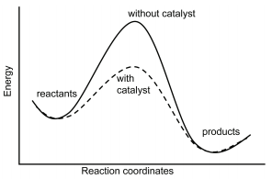
INTRODUCING…THE CATALYST OFFICE
Serving to bridge the intersection between the science world and business world
Three cornerstone programs within Catalyst:
Accelerator Network
BARDA Ventures
DRIVe Start
CATALYST: a substance that increases the rate of a chemical reaction without itself undergoing any permanent chemical change.

Slide 7
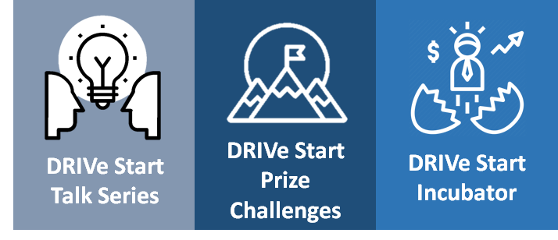
DRIVe Start – Program Innovation & Alliance Activities
A program designed to find new ideas and support their development through:
Tuesday Talk Series
Prize Competitions
DRIVe Start Incubator*
Community engagement events with internal & external partners
Notes:
Building relationshps
Community Engagement
+ third category

Slide 8
Chemical Repurposing: DRIVe ReDIRECT - AOI #5 “Treat the Injury, Not the Agent”
Holy Grail:
An easily accessible and effective MCMs that is available in community hospitals, pharmacies, and within the community
Chemical Repurposing Pipeline
Chem Branch
FDA Approval
DRIVe
Proof of Concept Studies
Advanced Clinical Development
Primary & Secondary Indications
Focus Areas: Pulmonary agents, vesicants, opioids, blood/metabolic agents, organophosphates or nerve agents, and computational approaches to drug discovery for chemical repurposing

Slide 9








medicalcountermeasures.gov Portal to BARDA: Register to request a TechWatch meeting!
beta.sam.gov/ Official announcements and info for all government contract solicitations
phe.gov/BARDA Program description, information, news, announcements
drive.hhs.gov Learn about DRIVe, including our Accelerator Network and EZ BAA
www.usajobs.gov Join the team!
@BARDA
Biomedical Advanced Research and Development Authority
@BARDAGOV

